Slide 1



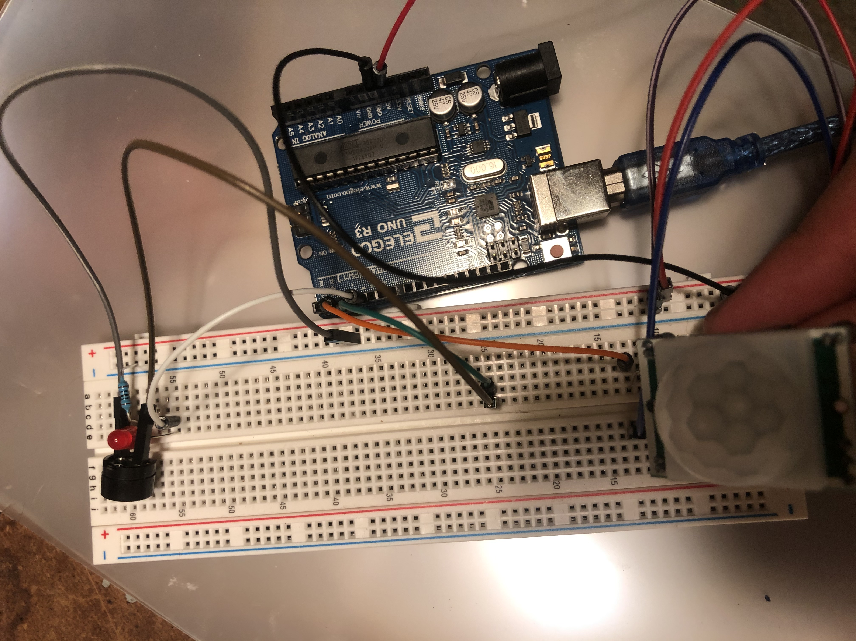

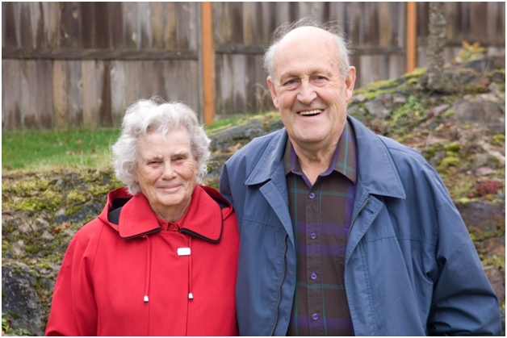

AutoRing! – the opposite of “single use”
Charles Richardson - HMW create a versatile, and simple tool with the Arduino for around the home
What does this solve? Many problems!
Simplifies the home alarm system for the not so tech savvy
Alerts residents of anyone entering their home or passing through a zone. (Ex. if installed in hallway)
Assist with parking in a tight garage
Why is this unique?
Low cost
Versatile, uses for many types of people and lifestyles
Portable, use it for a high school project at school , then gift it to your grandma
This Photo by Unknown Author is licensed under CC BY-SA-NC
This Photo by Unknown Author is licensed under CC BY-SA
This Photo by Unknown Author is licensed under CC BY

